Slide 1


托福听力10
金牌听力名师
大菁儿老师
2021.6.22

Slide 2
第九节课回顾： 边缘学科词汇串讲 business+history菁讲精练

Slide 3
边缘学科词汇串讲
二级学科词汇精讲：人类+建筑学
综合练习及考前注意事项

Slide 4
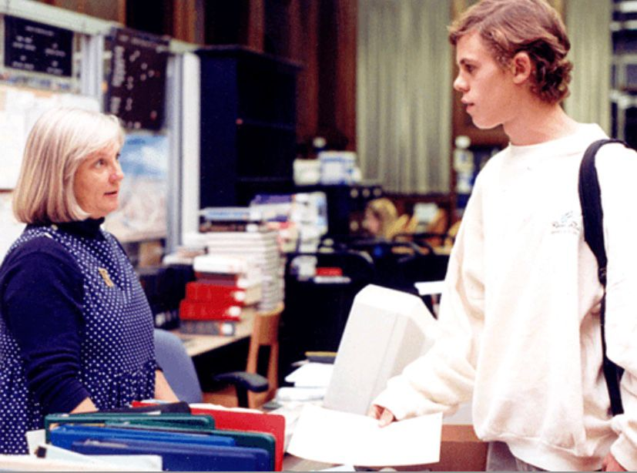
TPO49-con1

Slide 5
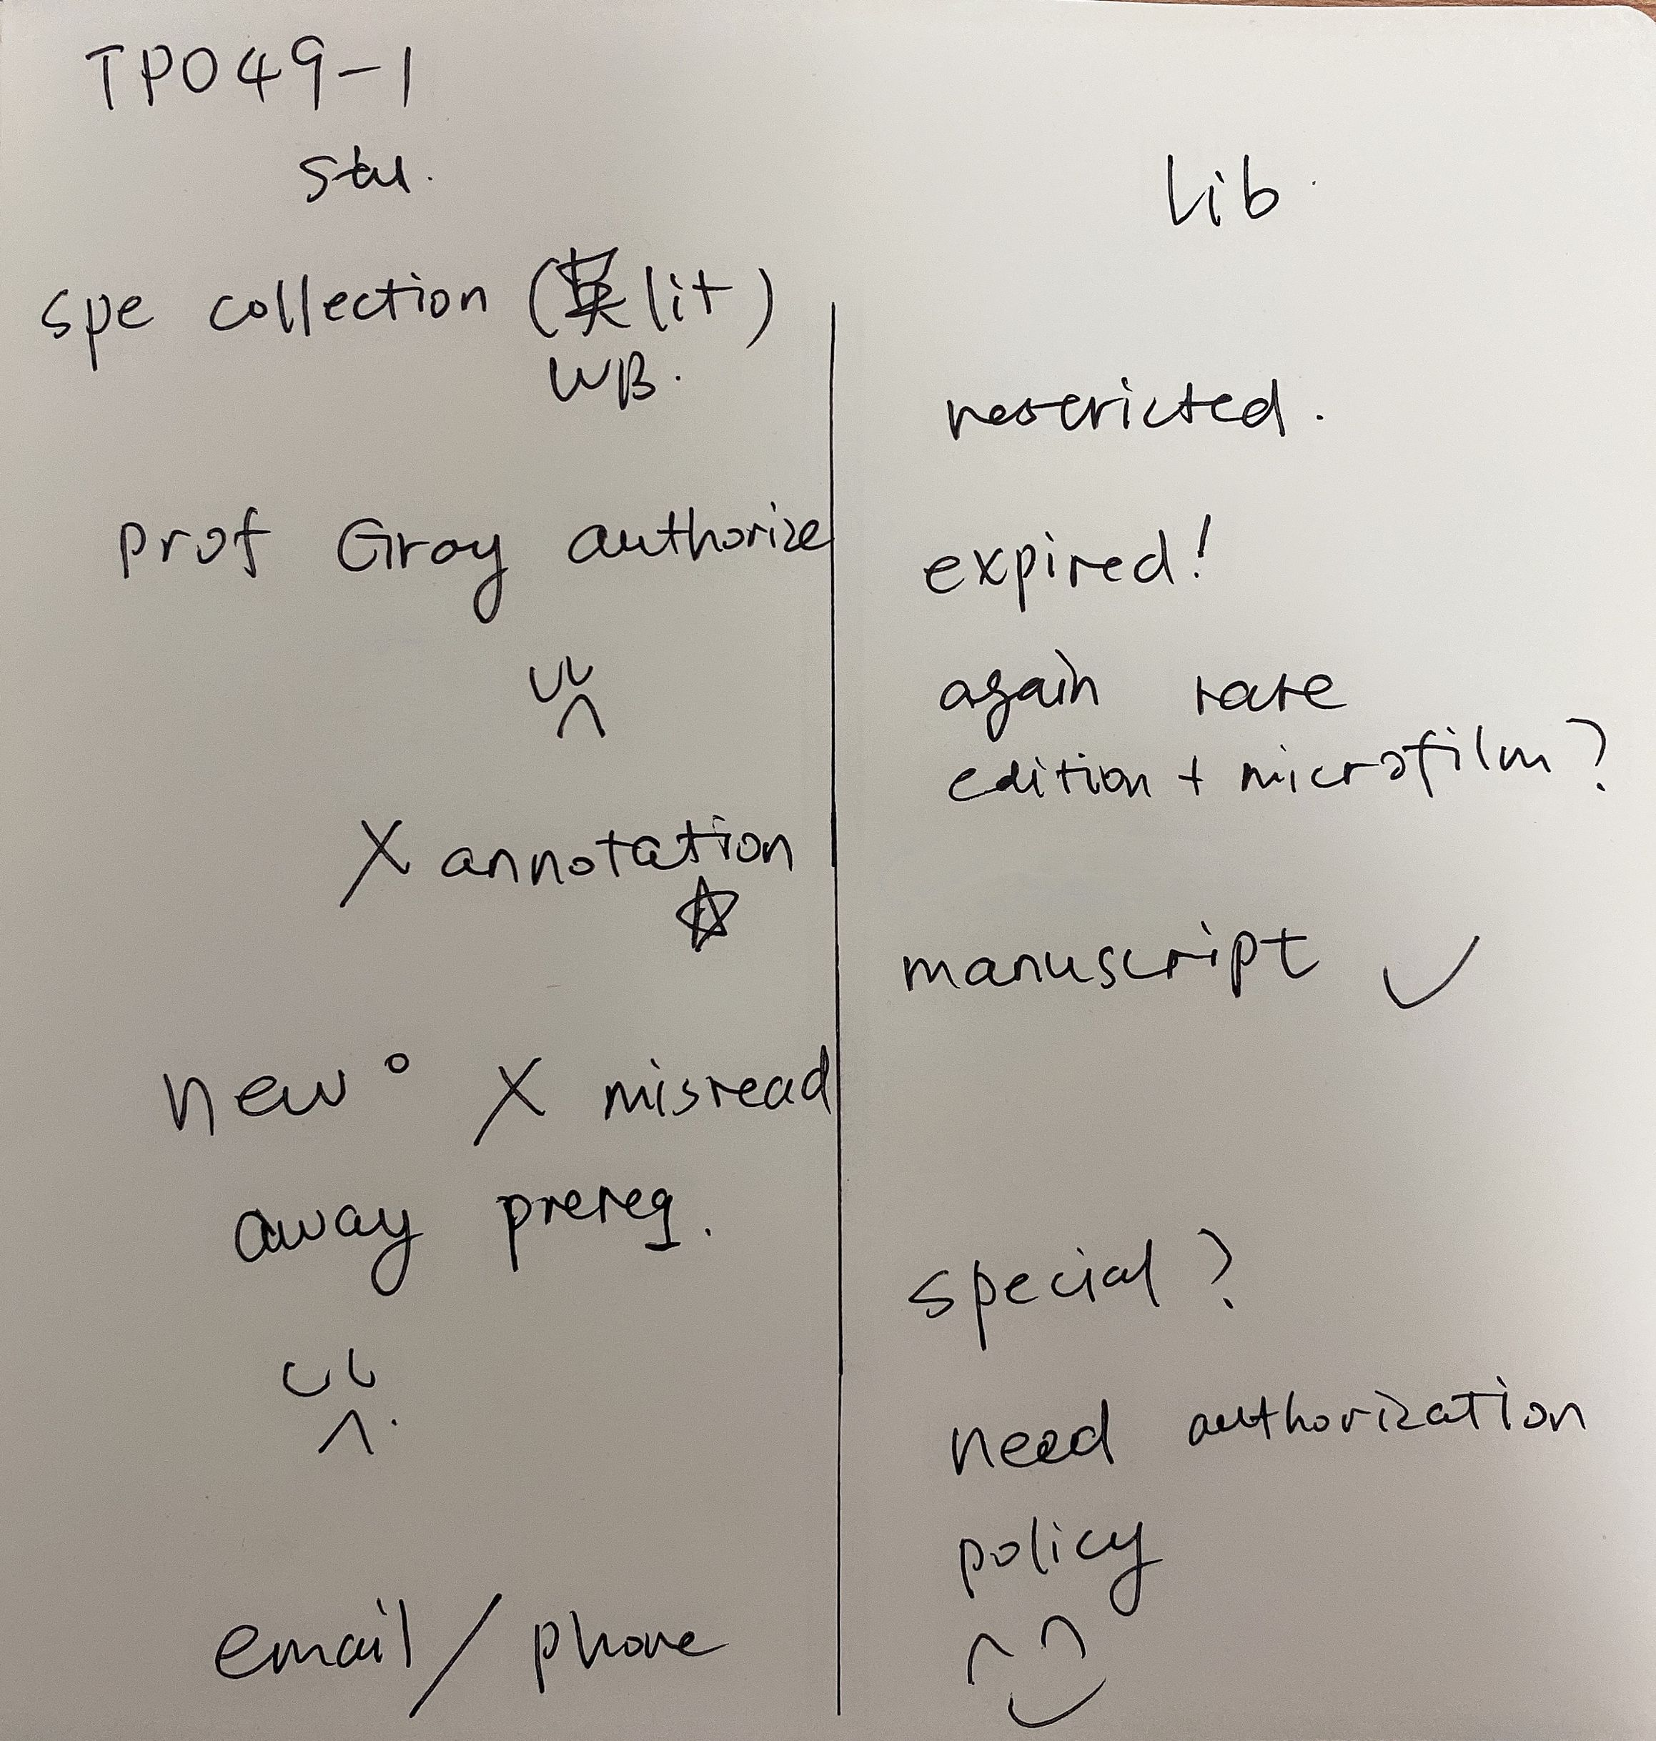
TPO49
con1
笔记

Slide 6
TPO49-con1
1.What are the speakers mainly discussing?
A. The student's difficulties locating sources for a research project
B. The topic of the student's research project
C. The student's request to visit a particular part of the library
D. Procedures for requesting different editions of a book

Slide 7
TPO49-con1
2. Why is the student unable to use later editions or reproductions of a book he mentions?
A. The later editions contain errors.
B. Professor Gray specified the use of a particular edition.
C. The later editions must be requested from another library.
D. Reproductions typically omit the specific material he needs.

Slide 8
TPO49-con1
3 .Why is the student reluctant to contact Professor Gray?
A. He already has disturbed her several times during her time away from campus.
B. He does not feel comfortable about asking her for another favor.
C. He does not know her e-mail address.
D. He wants to surprise her with a completed project.

Slide 9
TPO49-con1
3 .Why is the student reluctant to contact Professor Gray?
A. He already has disturbed her several times during her time away from campus.
B. He does not feel comfortable about asking her for another favor.
C. He does not know her e-mail address.
D. He wants to surprise her with a completed project.

Slide 10
TPO49-con1
4. What does the woman imply about the rules regarding Special Collections?
A. The rules are unfair to the students.
B. The rules are in place to protect the books.
C. The rules are determined by the professors.
D. The rules have changed since the previous semester.

Slide 11
TPO49-con1
4. What does the woman imply about the rules regarding Special Collections?
A. The rules are unfair to the students.
B. The rules are in place to protect the books.
C. The rules are determined by the professors.
D. The rules have changed since the previous semester.

Slide 12
TPO49-con1
5.What does the woman mean when she says this:
A. She has been in a similar situation herself.
B. She will help the student solve his problem.
C. She has often heard this kind of story from students.
D. She thinks the student should try to understand her situation.

Slide 13
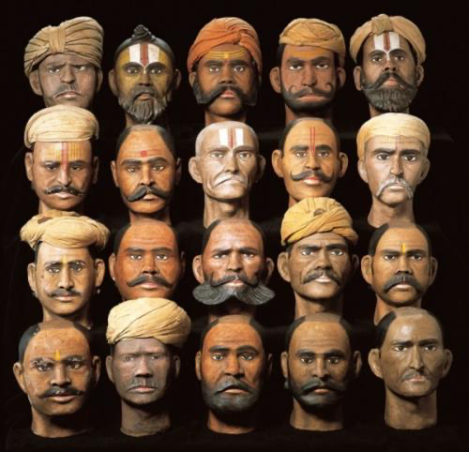
Anthropology 场景词汇
band [bænd] n.队；群
tribe [traɪb] n.部落；族
chiefdom ['tʃifdəm] n.酋邦；酋长的领地（权利）
state [stet] n.国家；州
horde [hɔrd] n.群；游牧部落
alliance [əˈlaɪəns] n.联盟，联合；联姻
federal ['fɛdərəl] adj.联邦的；同盟的
federation ['fɛdə'reʃən] n.联合；联邦；联盟；联邦政府
centralized authority ['sɛntrəl,aɪzd] [ə'θɔrəti] 中央集权
hierarchy ['haɪərɑrki] n.层级；等级制度
cradle ['kredl] n.发源地；发祥地；摇篮
site [saɪt] n.地点；遗迹；遗址
sedentary ['sɛdntɛri] adj.定居的
nomadic [nəʊ'mædɪk] adj.游牧的
mound [maʊnd] n.土堆；小丘
pit [pɪt] n.深坑；凹陷；矿井
ditch [dɪtʃ] n.沟渠；壕沟; v.挖沟

Slide 14
Anthropology 场景词汇
drainage ['drenɪdʒ] n.排水；排水系统
channel ['tʃænl] n.河床；河道；沟渠
hunter-gatherer ['hʌntə'ɡæðərə] n.采集狩猎的人
egalitarian [ɪ'gælə'tɛrɪən] n./adj.平等主义（的）
feudalism ['fjʊdl'ɪzəm] n.封建主义；封建制度
prevalent [ˈprɛvələnt] adj.流行的；普遍的，广传的
cultivate ['kʌltɪvet] v.耕种；种植
portage ['pɔ:rtɪdʒ] n.搬运；运输
mass transport [mæs][træn'spɔːt] 大宗运输

Slide 15
Anthropology 精讲精练：
TPO7-lecture3 易洛魁人和桦树
Iroquois and Huron people
birth tree 白桦树
utensils and containers 器具
pliable
cord 绳子
sturdy canoe 坚固的独木舟 强健的
sticky liquid 粘液
resin 树脂
stitch 缝 seal 密封
watertight 不漏水的
waterproof 防水的
cargo 货物
maneuverable 容易操作的
portage 搬运
form alliance 形成联盟 、federation 联盟

Slide 16
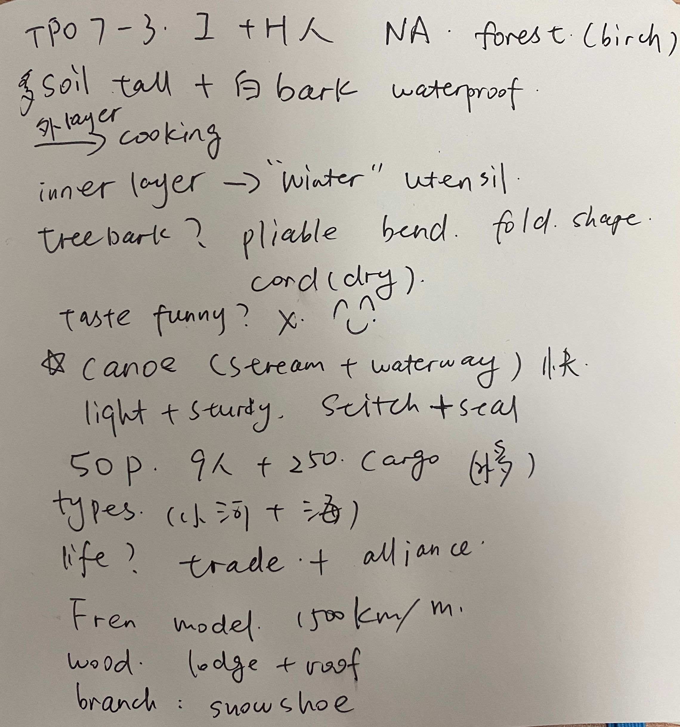
TPO7
lecture3
笔记

Slide 17
TPO7-lecture3
1.What is the lecture mainly about?
A.Different kinds of trees used for building canoes
B. Various methods of Native American transportation
C. The value of birth trees to some Native American groups
D. The trading of birth wood products by Europeans in North America

Slide 18
TPO7-lecture3
2. According to the professor, what characteristic of birth bark made it useful to Native Americans?
Click on 2 answers
AIt repels water
BIt can be eaten
CIt is easy to fold
DIt has a rough texture

Slide 19
TPO7-lecture3
3. According to the professor, why was the canoe important to some Native American groups?
Click on 2 answers
AThere was a network of waterways where they lived
BSnowy winters made land travel too difficult
CSome Native American groups sold their canoes to other groups
DCanoe travel helped form relationship between groups of Native Americans

Slide 20
TPO7-lecture3
4.Why does the professor mention French traders who arrived in the Iroquois region?
ATo illustrate how far news of the Iroquois canoe design had traveled
BTo explain the kinds of objects the Iroquois received in exchange for their canoes
CTo support her point about how efficient the Iroquois canoe design was
DTo emphasize that the Iroquois were first settlers in that region

Slide 21
TPO7-lecture3
5. why does the student say this
ATo share what he knows about birch wood
BTo point out a misprint in the textbook
CTo bring up a point from a previous lecture
DTo request more explanation from the professor

Slide 22
TPO7-lecture3
6.Why does the professor say this
ATo show how slow canoe travel was
BTo illustrate the size of a geographic area
CTo compare different means of travel
DTo describe how waterways change over time

Slide 23
city planning场景词汇
city planning ['sɪtɪ]['plænɪŋ] 城市规划
layout ['leaʊt] n.布局
suburb ['sʌbɜːb] n.郊区
rural ['rʊrəl] adj.乡村的；农村的
downtown ['daʊntaʊn] n.市区
urban ['ɝbən] adj.城市的
public transportation ['pʌblik] [,trænspɔr'teʃən] 公共交通
terminal ['tɜːmɪn(ə)l] n.航站楼, 终点
traffic congestion ['træfɪk] [kən'dʒestʃ(ə)n] 交通堵塞
transportation hub [,trænspɔr'teʃən] [hʌb] 交通枢纽

Slide 24
city planning场景词汇
infrastructure ['ɪnfrə'strʌktʃɚ] n.基础设施；公共建设
toll road [tol] – 收费公路
commute [kə'mjʊt] v./n.通勤
vehicle ['viːəkəl] n.车辆；交通工具
marginally [ˈmɑ:dʒɪnəli] adv.在边缘
convention center [kən'venʃ(ə)n] ['sentə] 会议中心
pedestrian mall [pəˈdestriən] [mɒl] 步行街

Slide 25
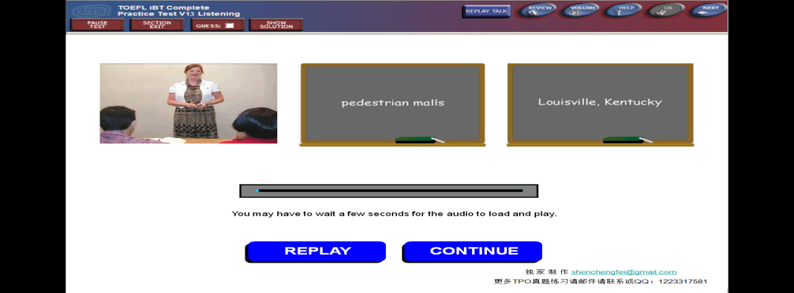
TPO13-lecture1 步行街的考虑要素
fountain
denominator 分母、共同特征
proximity 邻近

Slide 26
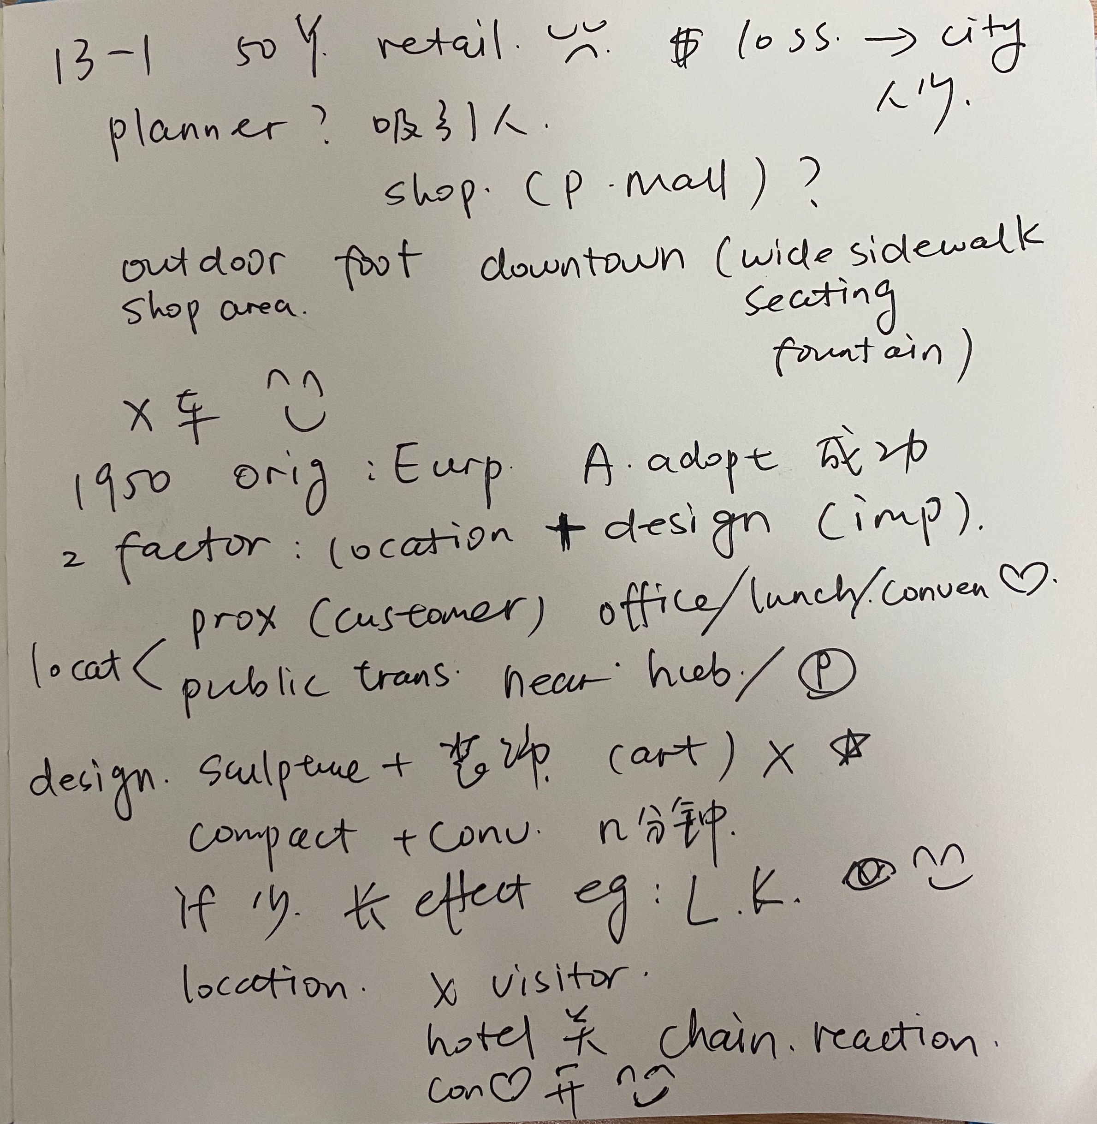
TPO13
lecture1
笔记

Slide 27
TPO13-lecture 1
1.What is the main topic of the lecture?
A How the first pedestrian mall was developed
B How pedestrian malls have affected business in America
C Key considerations in creating a pedestrian mall
D Ways that cities can better use pedestrian malls

Slide 28
TPO13-lecture 1
2.According to the professor, what is the basic reason for building pedestrian malls in the city center?
ATo increase retail activity in the area
BTo reduce the noise made by automobile traffic
CTo increase shopping conveniences for city residents
DTo encourage people to move from the suburbs back into the city center

Slide 29
TPO13-lecture 1
3.What are two aspects of location that need to be considered when planning a pedestrian mall?
Click on 2 answers
The proximity to the customer base
The number of nearby tourist sites
The variety of restaurants in the area
The access to public transportation

Slide 30
TPO13-lecture 1
4.Why does the professor explain the design of a pedestrian mall?
A To illustrate its importance to the success of a pedestrian mall
B To explain why pedestrian malls are so appealing to the shoppers
C To point out how a pedestrian mall looks different from other malls
D To show how the design is more important than the location

Slide 31
TPO13-lecture 1
5.Why does the professor mention the Louisville, Kentucky pedestrian mall?
ATo discuss her favorite pedestrian mall to visit
BTo illustrate how a pedestrian mall can overcome financial difficulties
CTo give an example of a typical, American pedestrian mall
DTo show how poor planning can affect the success of a pedestrian mall

Slide 32
TPO13-lecture 1
6.What does the professor mean when she says this? ...
AArt is of little importance in designing a pedestrian mall.
BThere should be a wide variety of art on display in pedestrian malls.
CArt is a key feature in the designing of a pedestrian mall.
DMost pedestrian mall designers do not like art as much as she does.

Slide 33
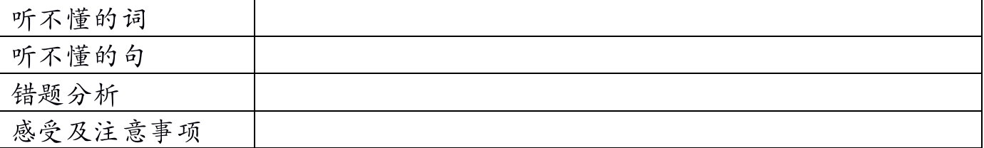
考前注意事项：
1. 高频考点了然于心
2. 英语氛围提前营造
3. 不容倒退，谨慎作答
4. 加试题目稳重对待
5. 心理备战不可走神

Slide 34
感谢 10次听力课的陪伴
等待同学们的好消息......

Slide 35
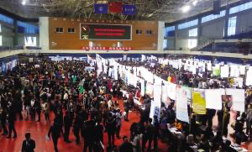
TPO6-con1

Slide 36
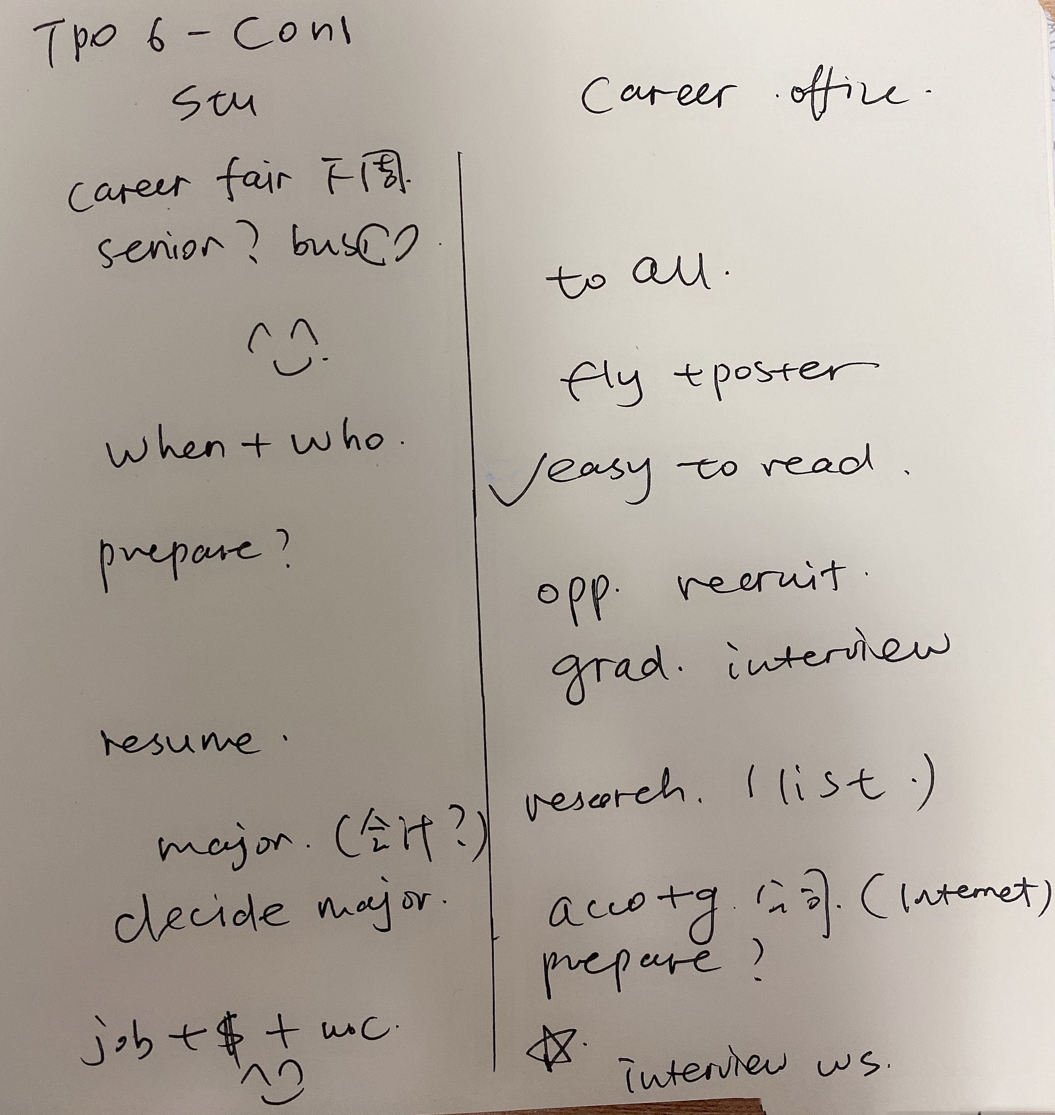
TPO6
con1
笔记

Slide 37
TPO6-con1
1. Why does the student go to the career services office?
A. to confirm the date and time of the career fair.
B. to learn the location of the career fair.
C. to find out he is allowed to attend the career fair.
D. to get advice about interviewing at the career fair.

Slide 38
TPO6-con1
2.Why does the student think that companies' representatives would not be interested in talking to him?
A. he will not be graduating this year.
B. he is not currently talking business classes.
C. he has not declared a major yet.
D. he does not have a current resume.

Slide 39
TPO6-con1
3.What does the woman imply about the small print on the career fair posters and flyers?
A. the information in the small print was incomplete.
B. the print was similar than she expected it to be.
C. the information the small print contains will be updated.
D. the information in the small print will be presented in a more noticeable way.

Slide 40
TPO6-con1
4.What does the woman say is a good way for the student to prepare for speaking to companies' representatives?
Click on 2 answers.
A. take some business classes.
B. familiarize himself with certain businesses beforehand.
C. have questions ready to ask the representatives
D. talk to people who work for accounting films

Slide 41
TPO6-con1
5 Why does the student say this?
A. To acknowledge that he cannot go to this year's career fair.
B. To acknowledge the amount of preparation he will have.
C. To indicate that he has school work he must complete before the career fair.
D. To indicate that he needs to go to his job now.

Slide 42
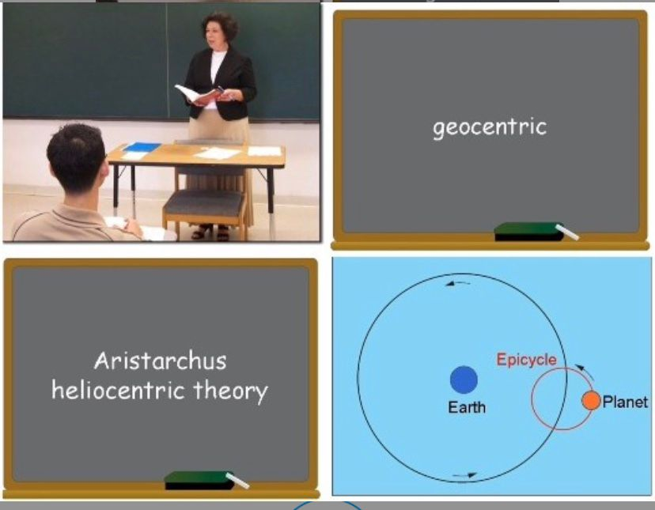
综合练习：
TPO21-L1

Slide 43
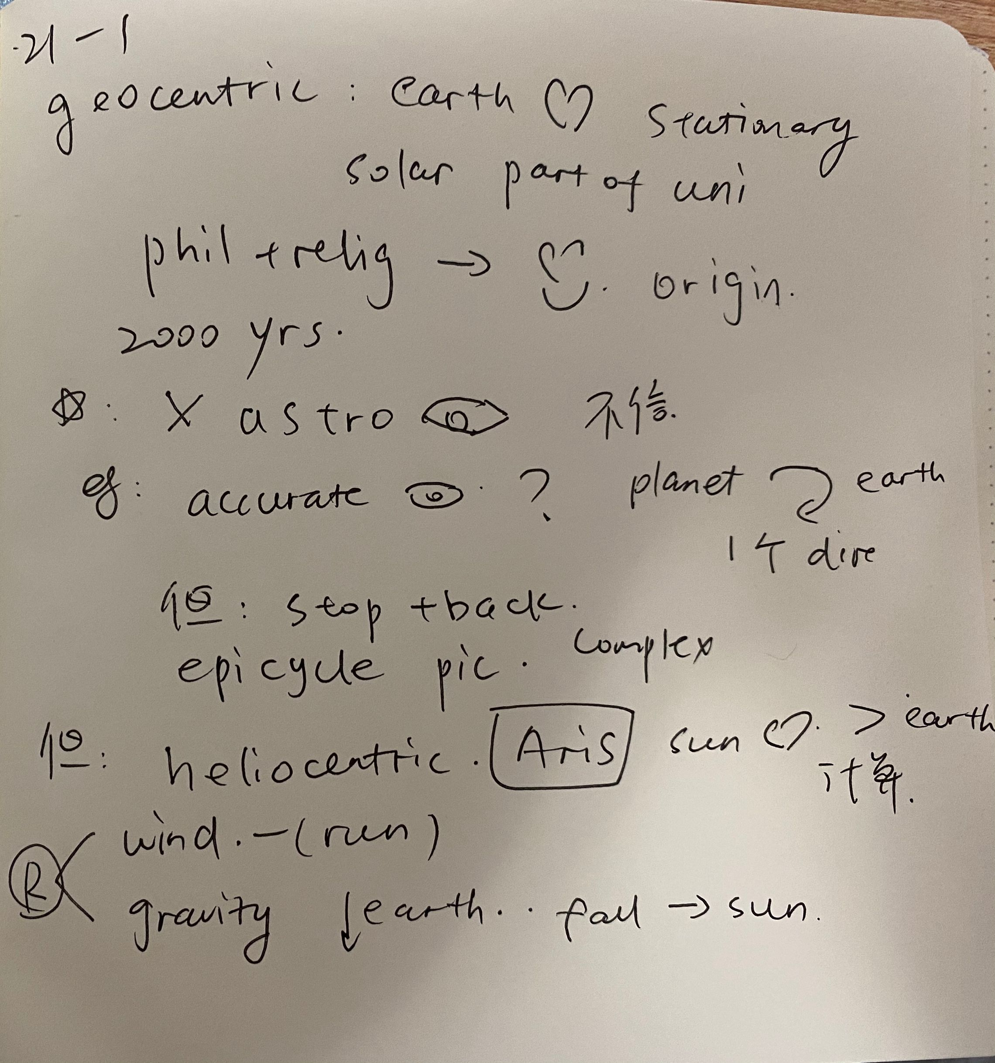
综合练习：
TPO21-L1

Slide 44
End

